Slide 1
Cancer data and efficient sequencing
Ruchik S. Yajnik

Slide 2
What is sequencing?
DNA sequencing is a broad collection of several methods which determine the order of the nucleic bases Adenine, Cytosine, Guanine and Thymine.
In our research we usually focus on Next Generation Sequencing as it has been shown to work with large datasets.

Slide 3
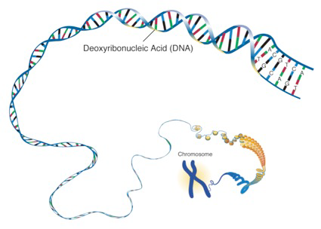
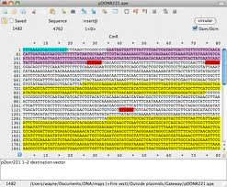
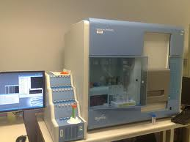
Key Players in Genetics
Notes:
http://biologylabs.utah.edu/jorgensen/wayned/ape/ (reads screen)
http://bytesizebio.net/index.php/2009/09/13/the-new-natural-history/ (Sequencing machine)

Slide 4
Reads from sequencing…
Genome
Reads

Slide 5
Deletion
Ref. Genome

Slide 6
Case Study: Triple –ve Breast Cancer
Triple negative breast cancer is caused due to a mutation in the BRCA1 gene.
According to the “Genetics Home Reference” website maintained by the NIH, the official name for this gene is: Breast Cancer 1, Early Onset.
Notes:
http://ghr.nlm.nih.gov/gene/BRCA1

Slide 7
BRCA1 in Detail
The BRCA1 gene belongs to a class of genes known as tumor suppressor genes.
Like many other tumor suppressors, the protein produced from the BRCA1 gene helps prevent cells from growing and dividing too rapidly or in an uncontrolled way.

Slide 8
BRCA1 cont.
Research indicates that BRCA1 regulates the activity of other genes and also plays a critical role in embryonic development.
Researchers have also indicated that most mutations (~1000) are related to an increased risk of breast cancer.
In addition to female breast cancer, it also increases risk for fallopian tube cancer, male breast cancer and pancreatic cancer.

Slide 9
How it gets bad…
The BRCA1 gene is written into our genome and so technically speaking we are at risk of cancer.
Triple –ve breast cancer has an early onset and so the double stranded DNA (dsDNA) will try to repair itself.
In the process of reparations, small deletions (indels) are introduced and thus copies of the defective dsDNA are created.

Slide 10
Trolling human genome…
Once the defective dsDNA is copied, more copies are made and at this point the defect from the original BRCA1 gene are added to the genome of the new dsDNA copies.
The accumulation of these indels causes the cancer to be more aggressive.

Slide 11
Project Goal
The aim for my project is to use an algorithm developed by the Ph.D. students in my group to look at these large datasets.
The algorithm/tool is called TreQ.
TreQ will be used to re-analyze datasets keeping efficiency in mind.

Slide 12
Additional Responsibilities
In addition to running TreQ on these datasets, I will also generate reports on these runs.
The reports and graphs will be included on the Wiki page of our group using certain Python modules.

Slide 13
Acknowledgements
NIH – Genetic Home Reference
University of Utah, Biology Labs, M. Wayne Davis – Reads Screen
Bytesizebio.net, Iddo Friedberg – Sequencing Machine

